Slide 1


Slide 2
Advanced Smart & Safety car with Object Detection & Parking
Batch - 2

Slide 3
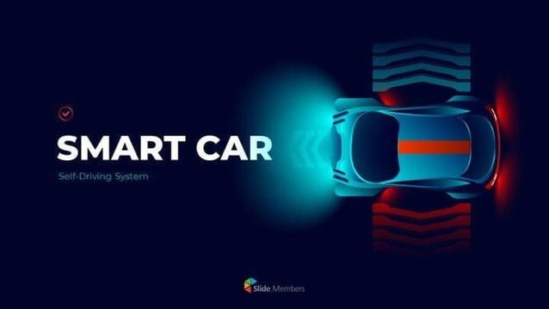
AGENDA
Abstract
Introduction
Components
Software’s Used
Programming Languages
Technologies
Literature Review
Reference

Slide 4
Abstract
Nowadays, we are facing many car accidents as the objects are not visible to us while driving and parking also when the drivers are driving the car when they are drunk. So we came up with a solution for that. We created a safer, more convenient driving experience using a Raspberry Pi and also advanced tech like IoT and AI.
A backup camera will be attached to the car. Using advanced computer vision techniques, the system identifies the objects within the environment and provides an immediate visual and textual feedback to the users.
Whereas for parking the car, 4 sensors will be placed at 4 ends of the car. The parking is done according to the distance calculation between the other cars or any other objects in the parking areas. If any car or object is detected, there will be a textual representation of that particular object on the screen so that the driver ensures safety while parking.
A chip will be placed on the car’s seat. Once the driver enters the car, the chip generates based in the car if the driver consumed alcohol.
The abstract highlights of the system's ability is to bridge the gap between physical objects and digital interfaces through real-time object detection, leveraging sensor based technology for intelligent car parking, alcohol detection and also enhancing user convenience.

Slide 5
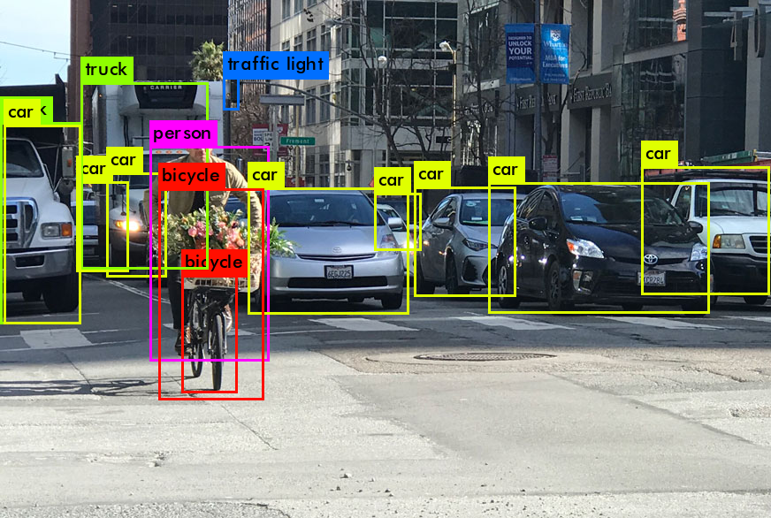
Introduction
OBJECT DETECTION :
The main task of autonomous driving is to accurately and quickly detect the vehicles, pedestrians, traffic lights, traffic signs, and other objects around the vehicles, in order to ensure the safety in driving.

Slide 6
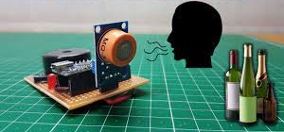
ALCOHOL DETECTION : The main purpose of the Alcohol Detection with Vehicle Controlling project is "Drunk driving detection". Nowadays, many accidents are happening because of the alcohol consumption of the driver or the person who is driving the vehicle. Thus Drunk driving is a major reason for accidents in almost all countries all over the world. The alcohol Detector in Car project is designed for the safety of the people seating inside the car. The alcohol Detection with Vehicle Controlling project helps to control the vehicle in case the driver has consumed alcohol. An alcohol breath analyzer project should be fitted/ installed inside the vehicle.

Slide 7
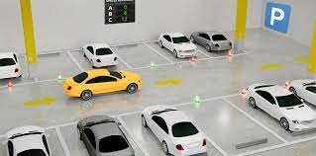
SMART PARKING : Due to the surge in urbanization, people don’t depend on public vehicles. They use their vehicles to travel. So, traffic increases. When people travel through a city the most difficult problem is to park the vehicle. It causes not only a waste of time and fuel for drivers looking for parking, but it also leads to additional waste of time and fuel for other drivers as a result of traffic congestion. The usage of automobiles has increased which in turn has led to traffic and parking difficulties. The most important thing is safe parking where we can't see the sides through camera perfectly so it is important to use safe parking mechanism

Slide 8
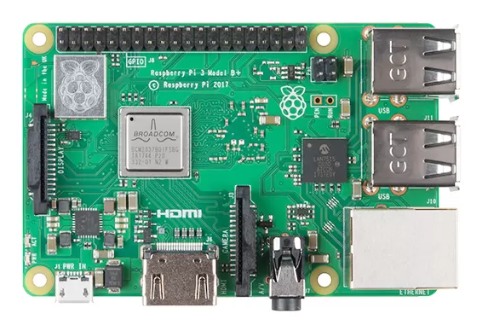
Components
Raspberry pi
IR sensor
Camera
Usb cable
Buzzer
Car Body
Car Tyers
SD card
Jumper Wires
Display / by using laptop
Remote control pcb
Antenna
Alcohol Detection sensor

Slide 9
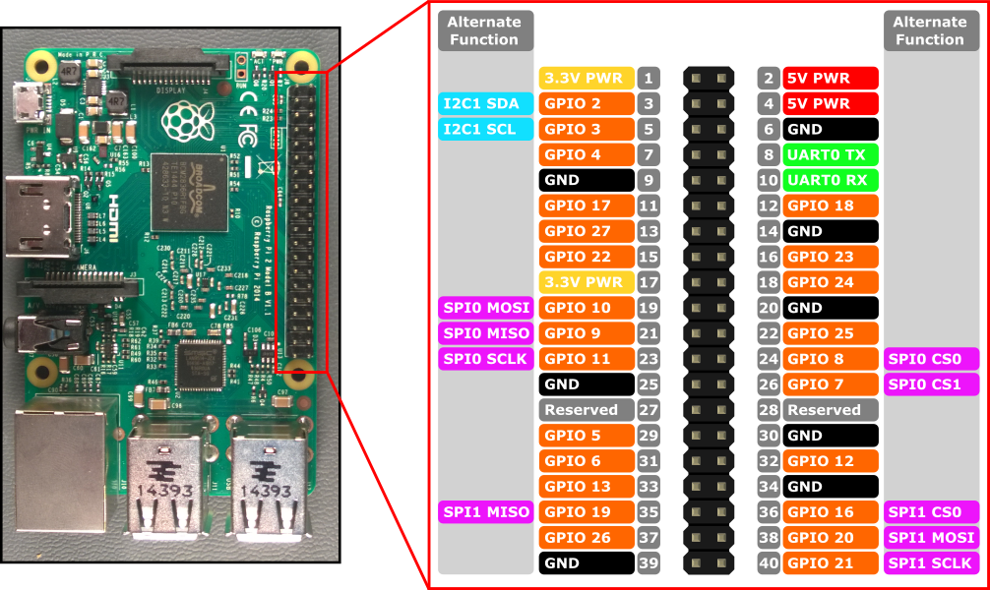
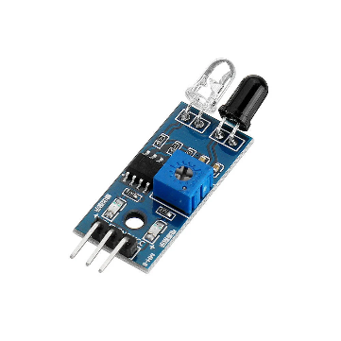
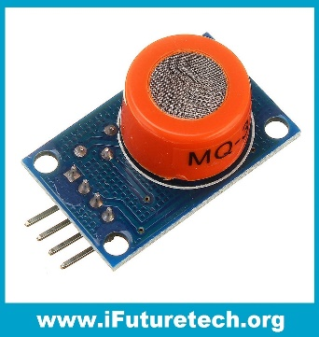
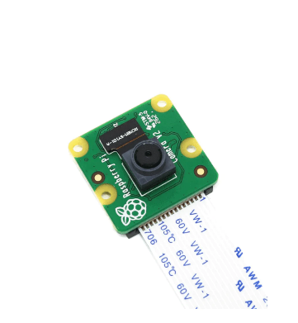
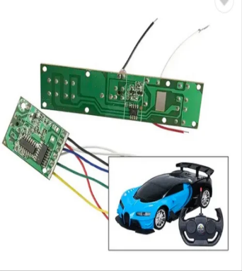

Slide 10

Software’s Used
Software’s used to move Car
MQTT
Mobile car controlling apps
Software’s used in Project
VNC Viewer
Proteus
Raspberry Pi software
Tensor Flow
Open cv

Slide 11
Programming Languages & Technologies
Programming Language’s
Technologies
Python
Java
Internet of Things (IoT)
Artificial Intelligence (AI)
Machine Learning (ML)

Slide 12
Literature Review
Deep Learning for Computer Vision" by Raja lingappaa Shanmugamani . This book provides insights into various deep learning techniques used in computer vision, including object detection. It covers both classical and modern approaches.
Hands-On Computer Vision with TensorFlow 2" by Benjamin Planche and Eliot Andres. This practical guide focuses on building computer vision applications with TensorFlow 2, including object detection using state-of-the-art models.
Breath Analysis for Clinical Diagnosis and Therapeutic Monitoring" by Anton Amann and David Smith This book explores the science and applications of breath analysis, including the detection of volatile organic compounds like alcohol. It covers clinical and diagnostic aspects.
Detection, Investigation, and Enforcement" by John C. Burnette and Jennifer A. Cramer. While primarily focused on DUI (Driving Under the Influence) investigations, this book provides insights into alcohol detection and enforcement techniques used by law enforcement agencies.
Internet of Things for Automotive: Shaping the Future of Connected Vehicles" by Venkatesh Prasad and Paul Mascarenas. It explores the role of IoT in automotive innovation, including sensors, data analytics, and vehicle-to-cloud communication.
Parking Management for Smart Growth" by Richard W. Willson. It explores strategies for managing parking in ways that promote safe and sustainable urban development, with a focus on creating walkable communities.

Slide 13
Reference Link
https://ieeexplore.ieee.org/document/10080037
https://ieeexplore.ieee.org/document/8589877
https://ieeexplore.ieee.org/document/9316049
https://www.researchgate.net/publication/301610593_Smart_parking_system_for_Internet_of_Things
https://ieeexplore.ieee.org/document/7414682
https://arxiv.org/pdf/1807.05511.pdf
https://ieeexplore.ieee.org/document/8405475
https://ieeexplore.ieee.org/document/8949265
https://ieeexplore.ieee.org/document/9124977
https://www.irjet.net/archives/V7/i9/IRJET-V7I943.pdf
https://ieeexplore.ieee.org/document/9071439

Slide 14
Thank you !
Batch - 2

